Slide 1
MSOC Final Project
High level synthesis for Image Deblurring Processor
Team 2
2021 01/22
r09943005 楊智翔 r09943021 舒泓諭 r09943113 董濟昀
Github: https://github.com/2020MSOC_Final

Slide 2
Outline
Motivation High-Quality Computational Imaging Through Simple Lenses [2013]
Algorithm Primal-Dual algorithm
Hardware architecture FFT module and matrix convolution
HLS Implementation Optimization for utilization and latency
Interface
Implement on FPGA
Conclusion

Slide 3

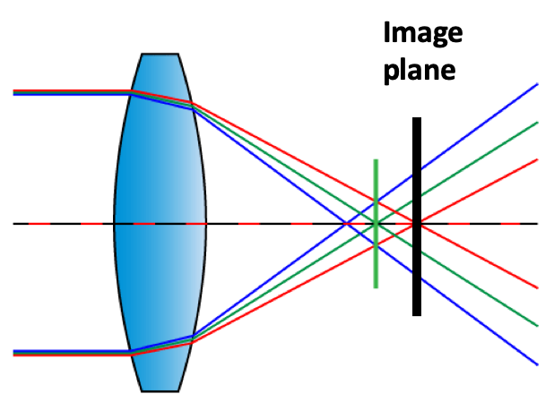
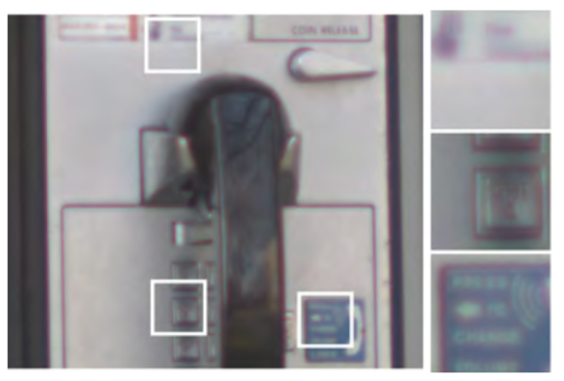

Motivation
Chromatic aberration is a long-existing issue in camera imaging technology. Due to the refraction difference of different colors of light, dispersion is inevitable through a single convex lens.

Slide 4
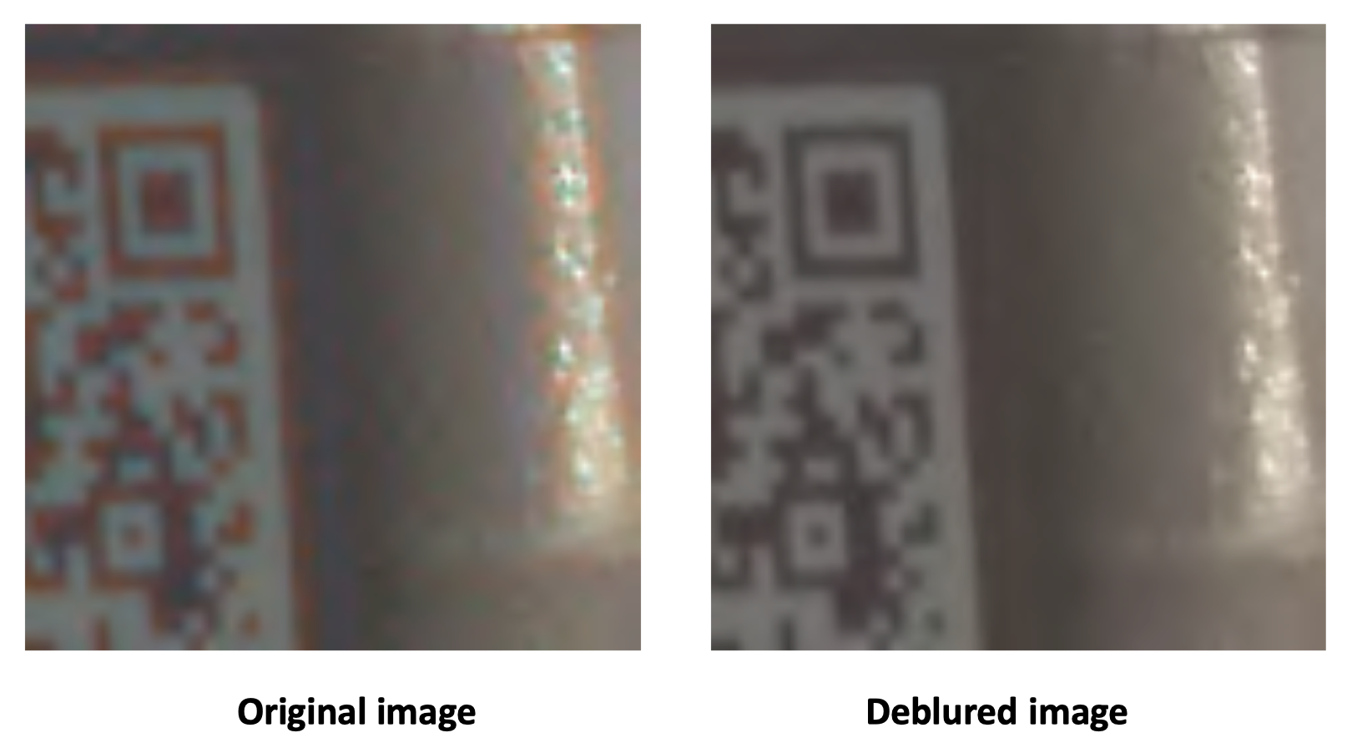
Motivation
High-Quality Computational Imaging Through Simple Lenses [2013] proposes solution to deblurring image.
For 256x256 image,original algorithm of 50 iteration takes 0.8222 second in matlab simulation. For larger image resolution(1920x1680), it couldn’t reach real time processing latency.

Slide 5
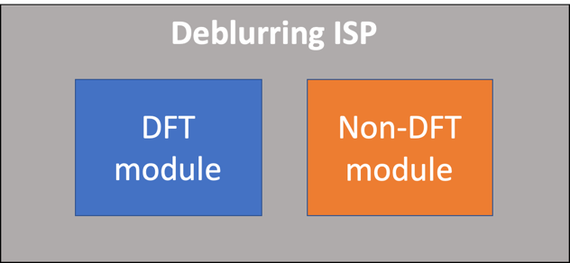
Goal
First HLS work for primal-dual for image deblurring
Real time image deblurring processor in Pynq-Z2

Slide 6
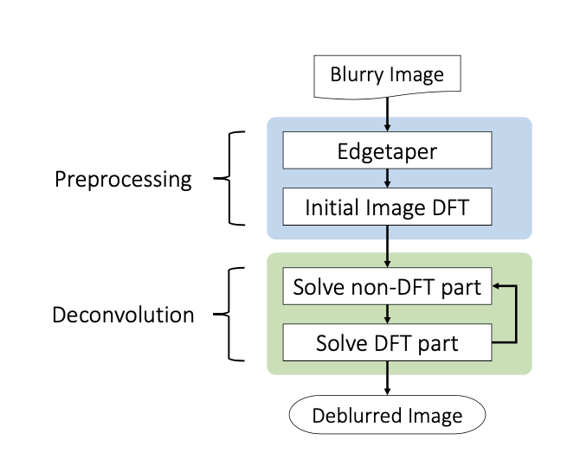
System flow
HLS implement

Slide 7
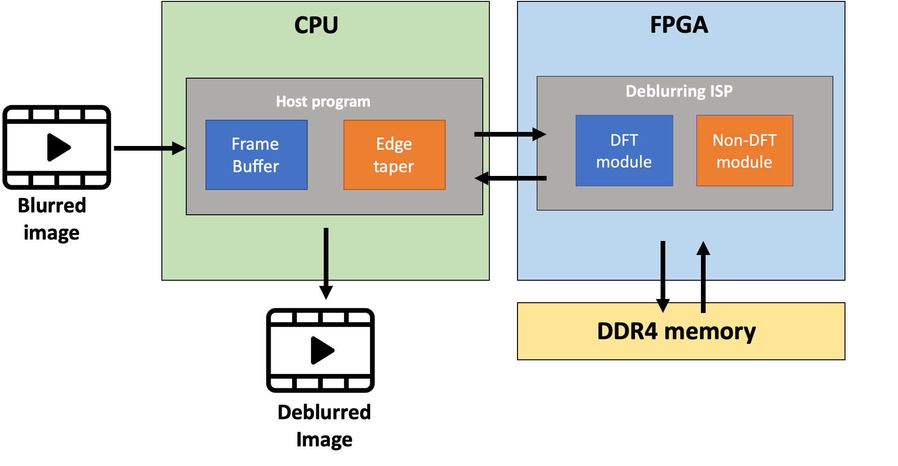
System block diagram
Image deblurring processing unit implemented in pynq-Z2

Slide 8
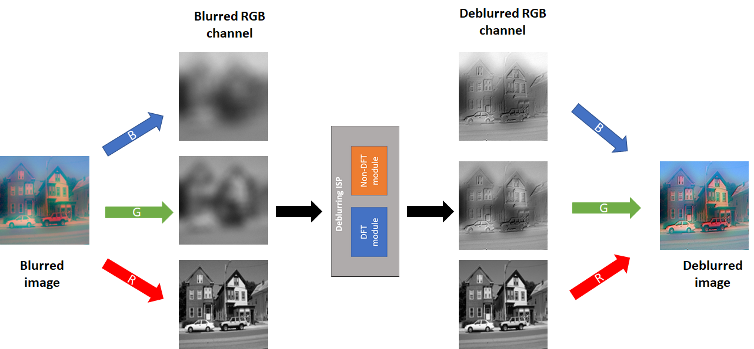
Image pocessing pipeline --- Deconvolution

Slide 9
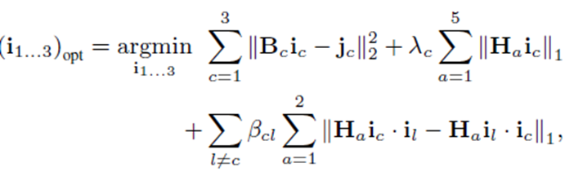
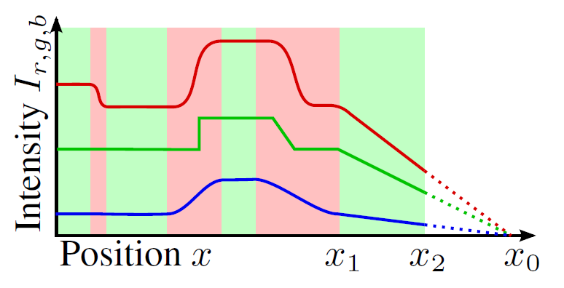
Objective function
Regulization term
Data term
TV norm
cross channel prior
Reconstruction goal
blur kernel
blurred image
Cross-channel prior enforces gradient consistency between the color channels.

Slide 10
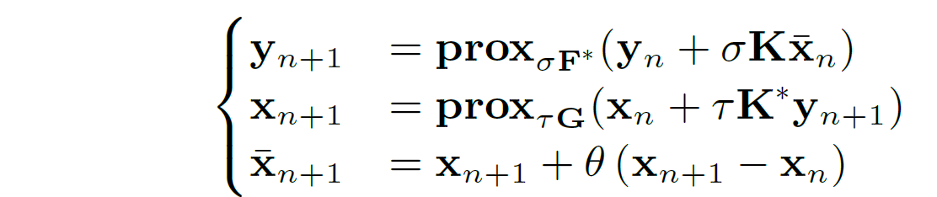
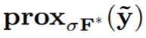
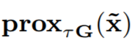
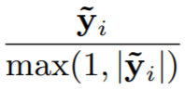
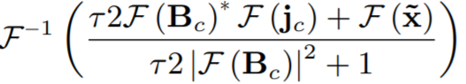
Algorithm
•Antonin Chambolle, Thomas Pock [2011]:
iteratively update primal variable and dual variable
primal step
dual step
over-relaxation step

Slide 11


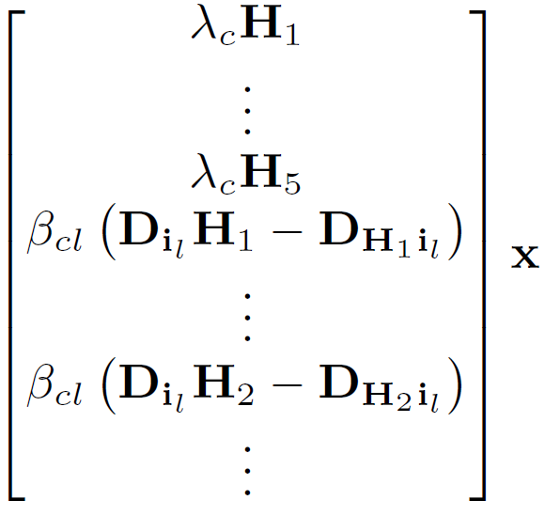
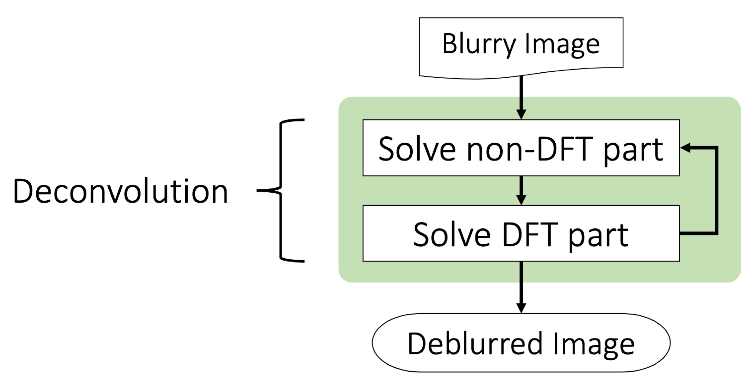

Hardware for deblur
implement matrix operation
implement 2D FFT for invertible matrix
operation in dual step

Slide 12
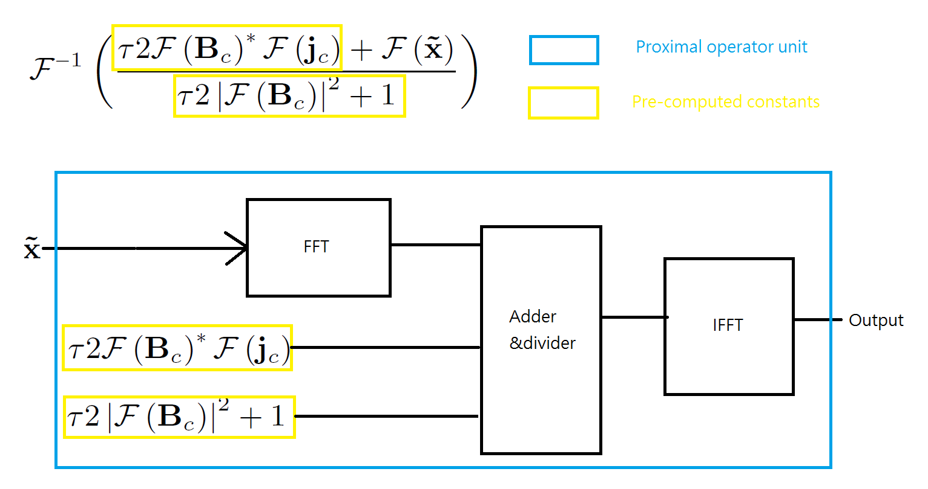
Proximal operator unit

Slide 13
2D FFT unit
Precision
Image domain 8 bit(0~255)
FFT domain 32 bit single precision(Real part /Imag part)
Xilinx logicCore IP Product library
128 point 1D FFT unit
Streaming architecture(Radix-2 butterfly)
Ref: pg109 LogiCORE IP Product Guide(Xilinx 2019)

Slide 14
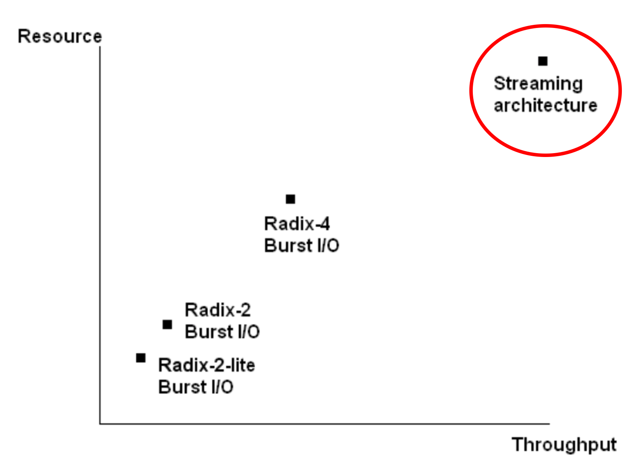
2D FFT unit
Xilinx logicCore IP Product library four types
 | Cycle number | DSP | BRAM
Radix-4, Burst I/O | 61596 | 20 | 50
Radix-2, Burst I/O | 177679 | 6 | 36
Radix-2, Lite I/O | 262183 | 3 | 38
Pipelined Stream | 32917 | 60 | 43
Resource v.s.Throughput

Slide 15
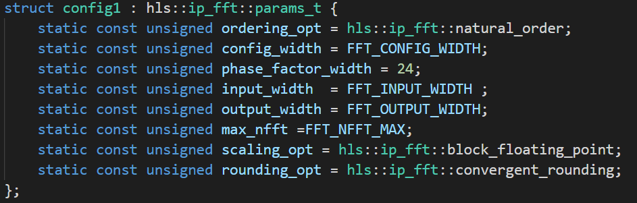
Xilinx IP usage
It’s very user friendly, and there’re two steps:
Define FFT parameter(ex: Precision, FFT length , Rounding type)

Slide 16
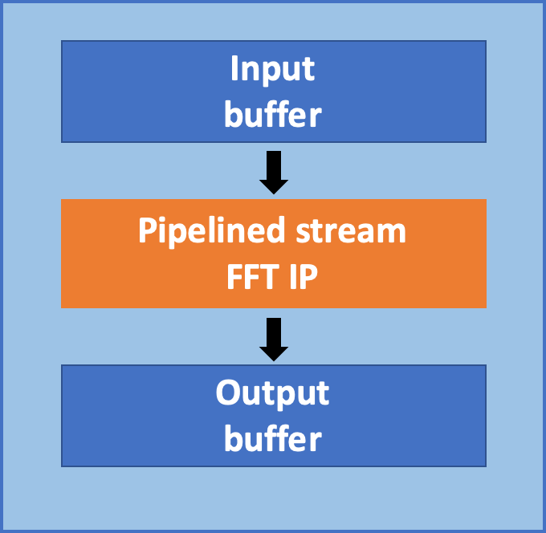
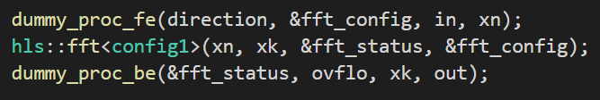
Xilinx IP usage
(b) Handle FFT I/O buffer ,and call fft function
1D 128
FFT unit

Slide 17
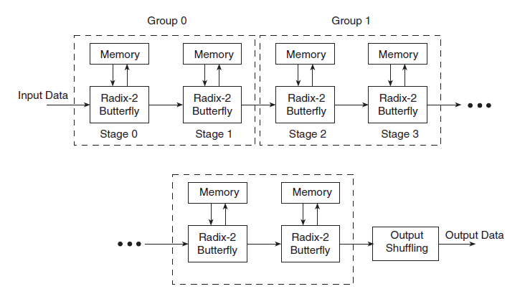
Streaming architecture (Radix-2 butterfly)
Each processing engine has its own memory banks
Pipelined architecture : simultaneously perform transform calculations on the current frame of data, load input data for the next frame of data

Slide 18
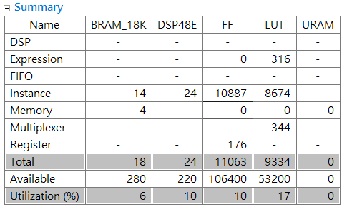
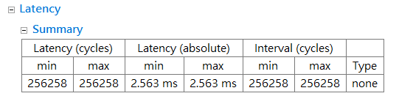
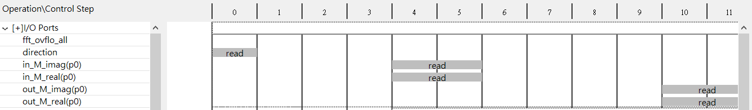
HLS optimization for 2D FFT unit
Long latency for 2D FFT unit
Timeline analysis for resource viewer

Slide 19
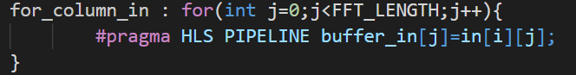
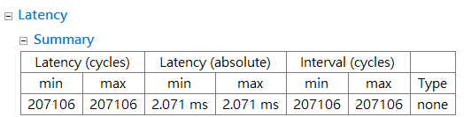
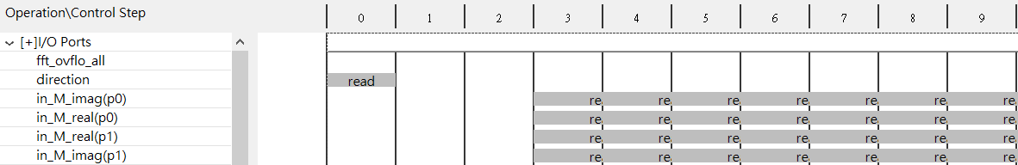
HLS optimization for 2D FFT unit
Shorter latency for 2D FFT unit
Timeline analysis for resource viewer

Slide 20
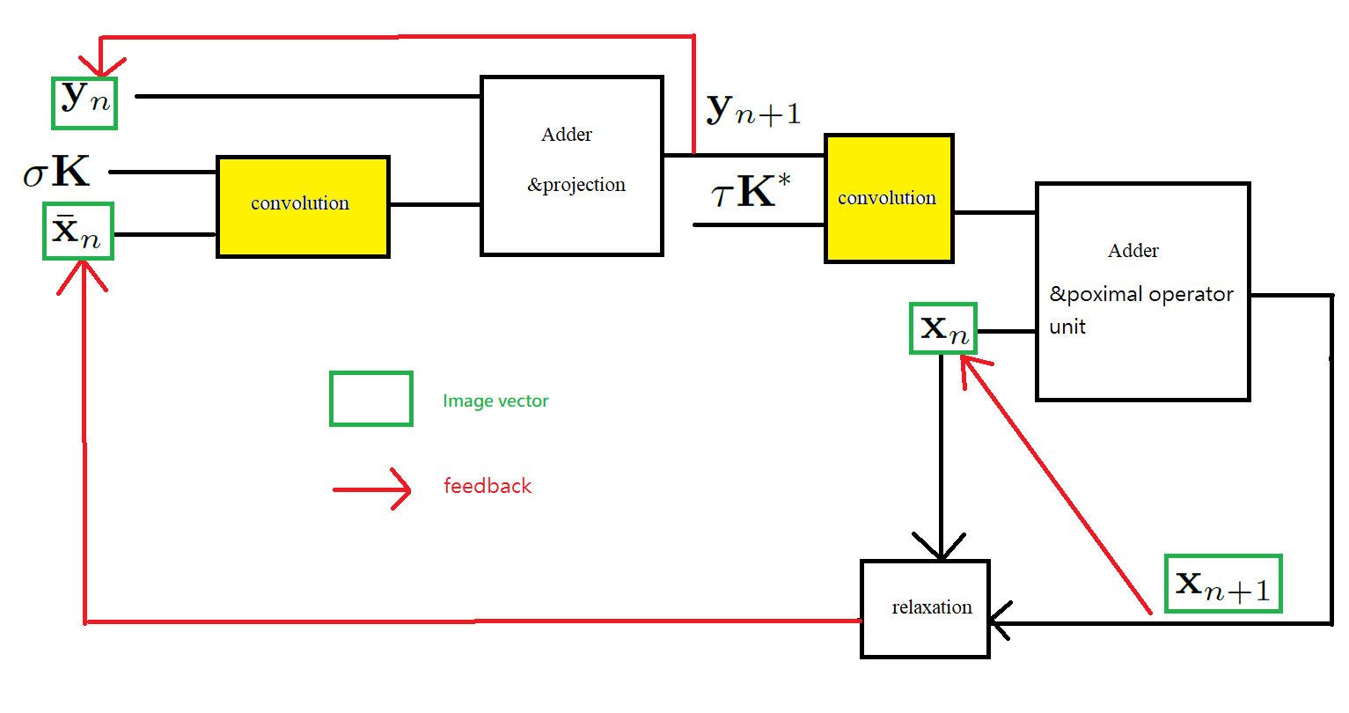
Deblurring unit

Slide 21
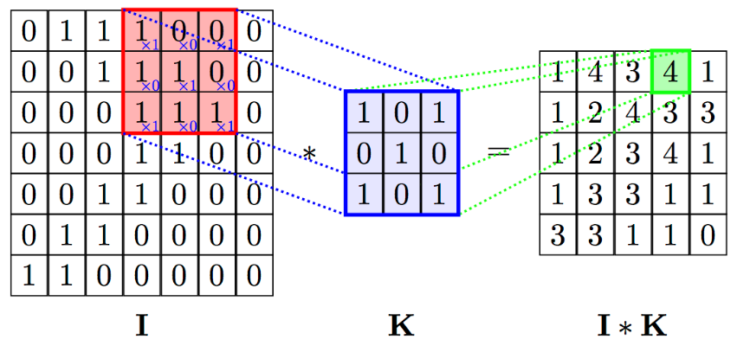
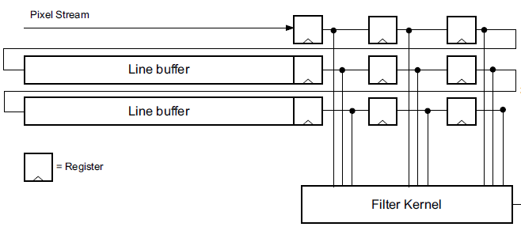
2D convolution with line buffer
#pragma HLS ARRAY_PARTITION variable=line_buffer complete dim=1
Output

Slide 22
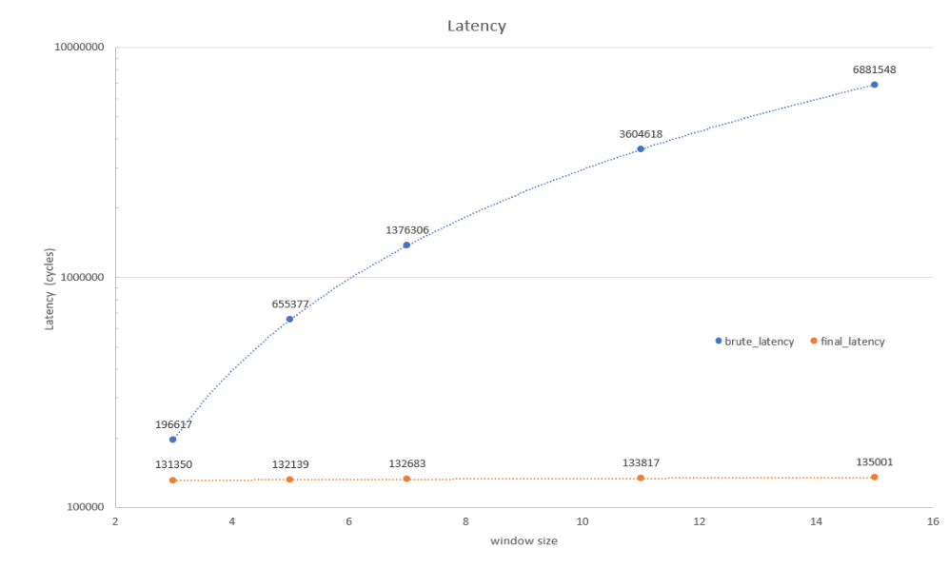
Brute force v.s. line buffer

Slide 23
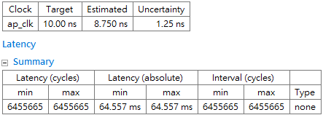
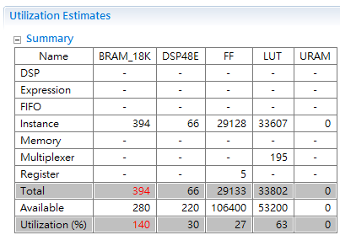
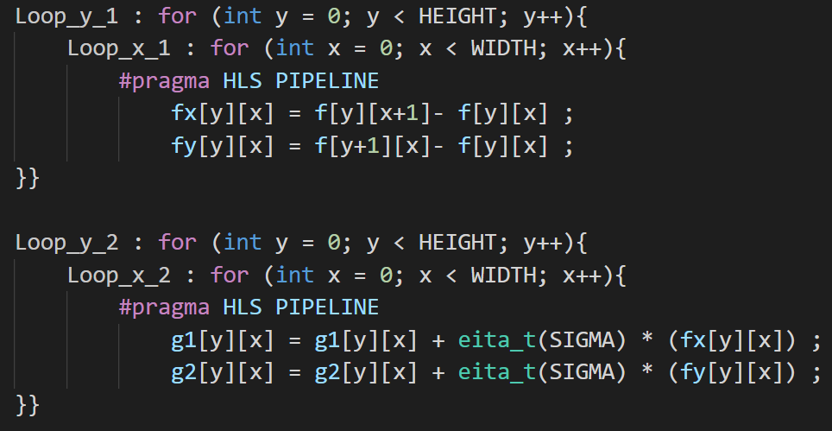
C code direct mapping

Slide 24
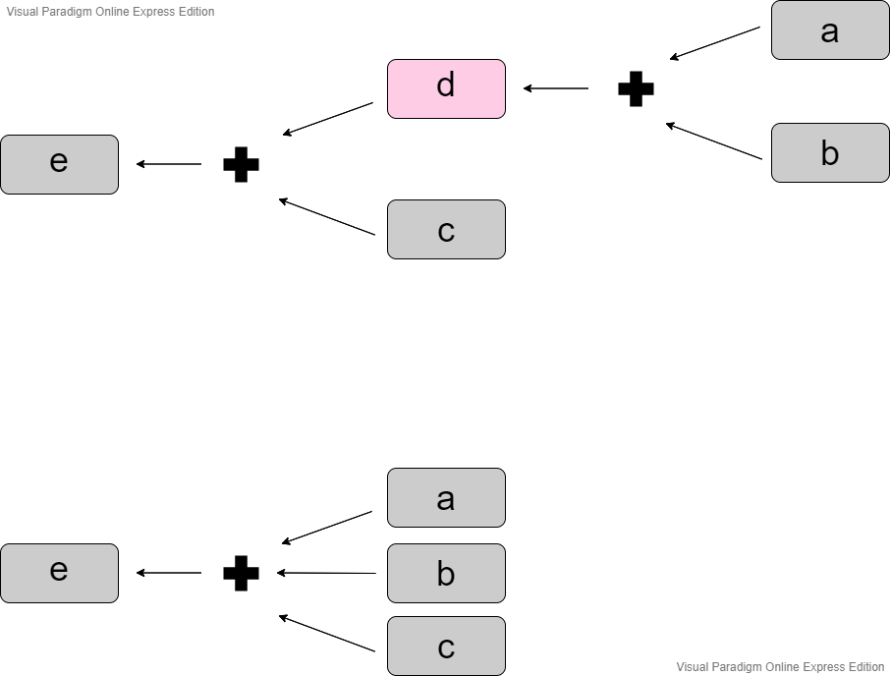
The difference of coding methodology between Software (C++) and Hardware (HLS)
e = a +b + c
HLS
d = a + b
e = d + c
C++

Slide 25

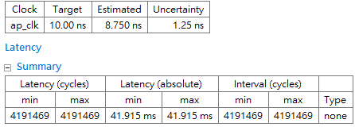
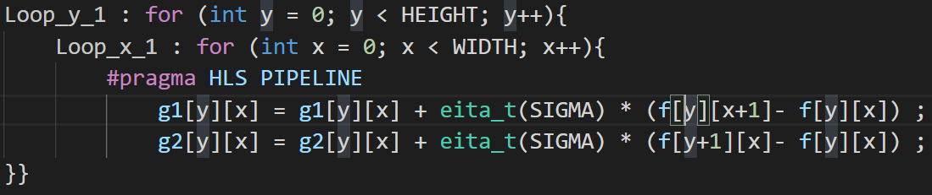
Preliminary HLS optimization

Slide 26
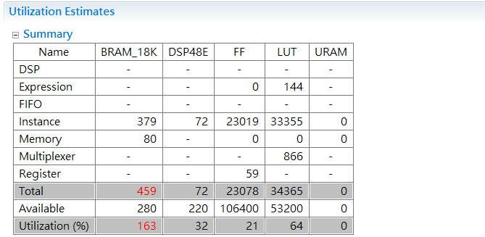
Utilization problems in iteration algorithm
Primal-dual algorithm is an iteration-based algorithm , many dual variables needs to be saved in BRAM. Furthermore, in order to preserve accuracy in dual variables , we use floating point data type, causing utilization problem. Thus we use DDR memory.

Slide 27
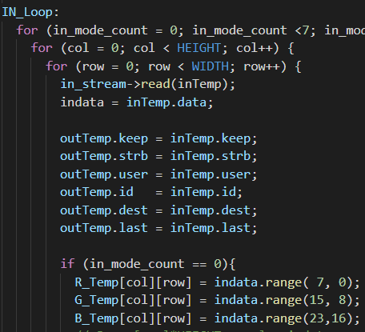
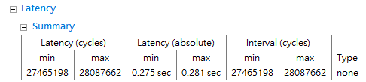
Interface
hls::stream< ap_axiu<32,1,1,1>>
Instream
outstream
s_axilite
Return
block level protocol indicate data on function port is valid and can be read

Slide 28
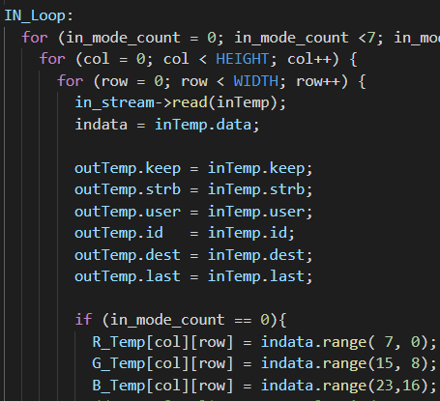
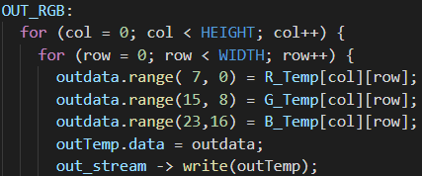
Data packing
decrease latency
decrease cycles used by axi stream
stream for R
need 128*128 cycles
stream for G
need 128*128 cycles
stream for B
need 128*128 cycles
total 3*128*128 cycles
ap_axiu<32,1,1,1> indata
indata( 7, 0) = R
indata(15, 8) = G
indata(23,16) = B
total 128*128 cycles

Slide 29
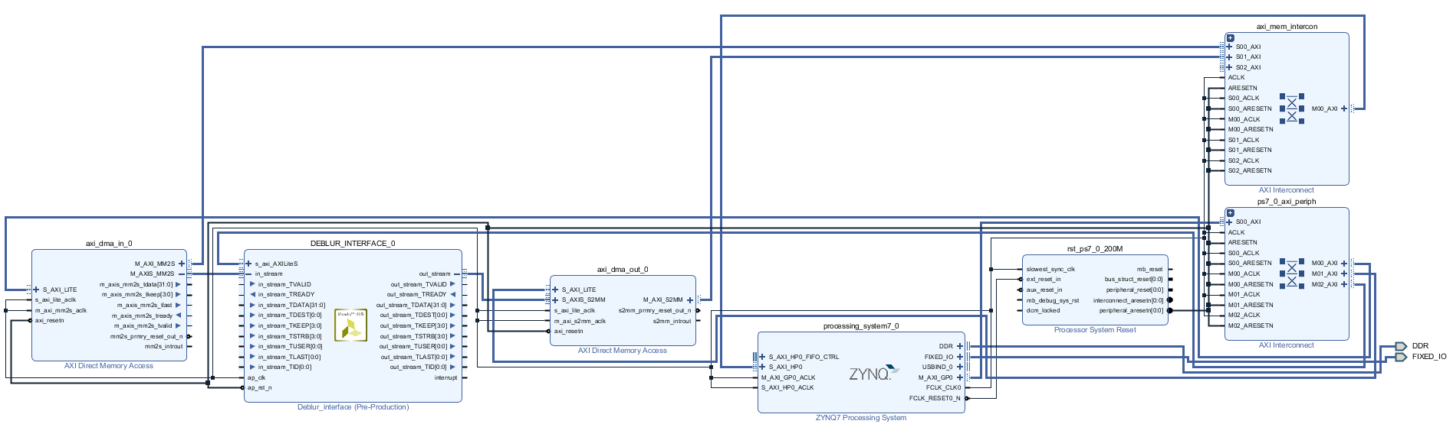
Block Diagram for AXI stream

Slide 30
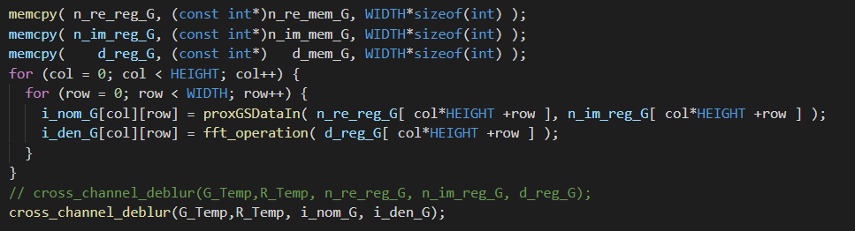
DDR memory
axi master burst
memcpy function
burst write of WIDTH ints from Ram to DDR

Slide 31
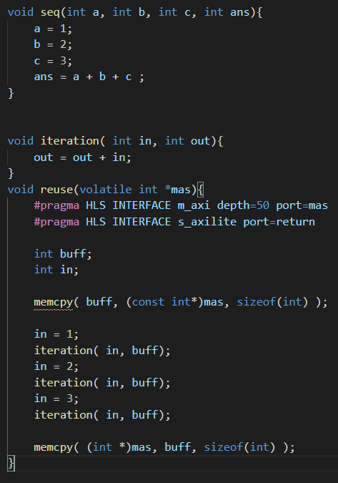
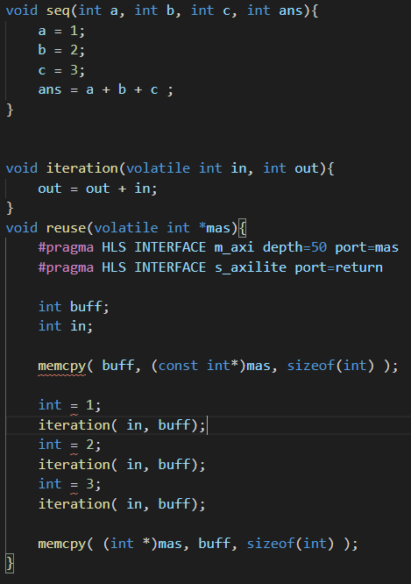
DDR memory
need to think about hardware usage
only register variables when needed
software coding style,
need 4 integer
hardware coding style, with memory reusing
only 2 integer

Slide 32
HLS Synthesize
Arrays in the C code synthesize into block RAM or UltraRAM in the final FPGA design
If the array is on the top-level function interface, high-level synthesis implements the array as ports to access a block RAM outside the design.
block level follow C++ memory assign logic

Slide 33
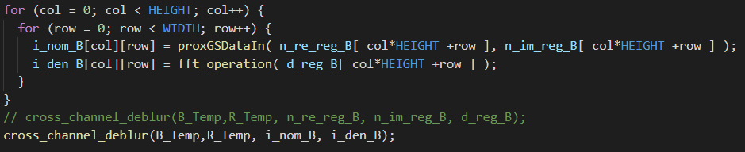
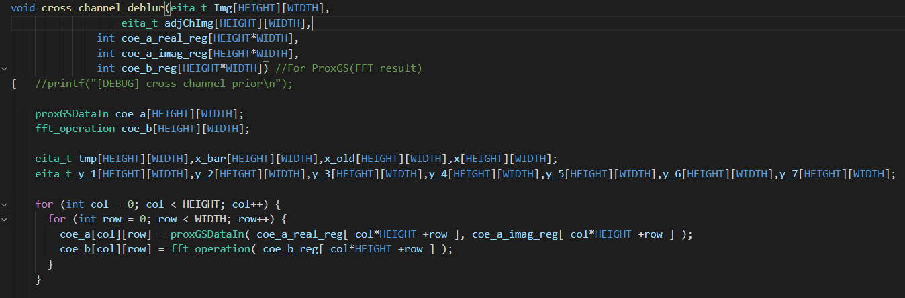
HLS Synthesize
array at top level
array in block level

Slide 34
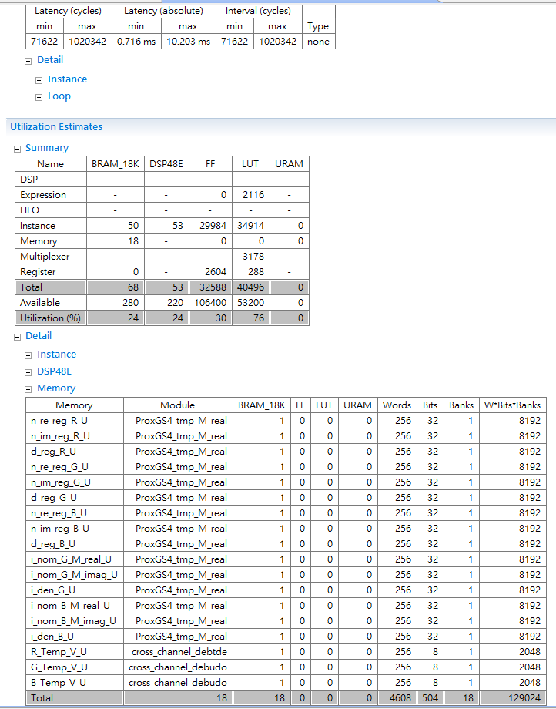

HLS Synthesize
same function, but different BRAM usage
array at top level
array in block level

Slide 35
Conclusion
First high level synthesis for image deblurring for primal dual algorithm
FPGA interface for delivering data
Github submit ：https://github.com/leo870823/2020MSOC_Final

Slide 36
Reference
An Image Deblurring Processor for Chromatic Aberration Based on the Primal-Dual Algorithm with Cross-Channel Prior (Chia-Han Huang,[2020 ISCAS])
High-Quality Computational Imaging Through Simple Lenses(Felix Heide,[2013])
A first-order primal-dual algorithm for convex problems with applications to imaging(Antonin Chambolle, Thomas Pock [2011])
HLS IP Library https://cloud.tencent.com/developer/article/1605517

Slide 37
Thank you for your attention

